Slide 1
Abstract Classes & Interfaces
BACS2023
Object-Oriented Programming Techniques
Chapter 7 – Part 2

Slide 2
Learning Outcomes
At the end of this chapter, you should be able to
Explain the similarities and differences between an abstract class and an interface.
Specify behavior for objects using interfaces
  Make objects cloneable using the Cloneable interface.
Apply the use of wrapper classes in programs.
Describe auto-boxing and unboxing.
Explain the rationale for wrapper classes.

Slide 3
1. Interfaces vs Abstract Classes (1)
  In an interface, the data must be constants; an abstract class can have all types of data.
  Each method in an interface has only a signature without implementation; an abstract class can have concrete methods.
 | Variables | Constructors | Methods
Abstract class | No restrictions | Constructors are invoked by subclasses through constructor chaining. An abstract class cannot be instantiated using the new operator. | No restrictions.
Interface | All variables must be public static final (ie constants) | No constructors. An interface cannot be instantiated using the new operator. | All methods must be public abstract instance methods

Slide 4
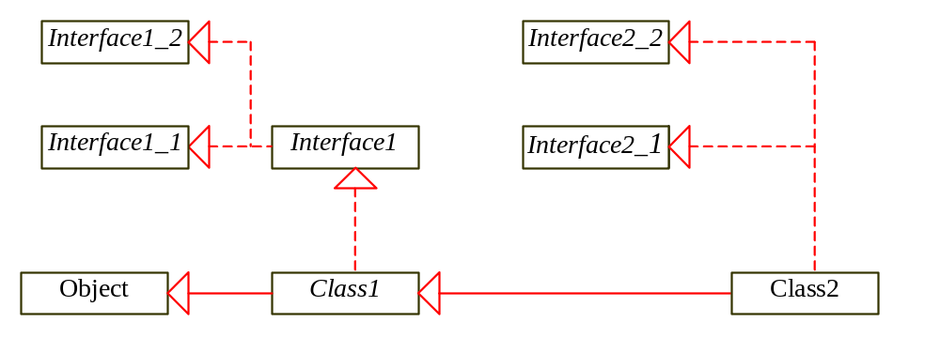
Interfaces vs Abstract Classes (2)
  If a class extends an interface, this interface plays the same role as a superclass.
  You can use an interface as a data type and cast a variable of an interface type to its subclass, and vice versa.
  Suppose that c is an instance of Class2. c is also an instance of Object, Class1, Interface1, Interface1_1, Interface1_2, Interface2_1, and Interface2_2.

Slide 5
Interfaces vs Abstract Classes (3)
  Abstract classes and interfaces can both be used to model common features.
  How do you decide whether to use an interface or a class?
    A strong is-a relationship that clearly describes a parent-child relationship should be modeled using classes.
    E.g. a staff member is a person  use class inheritance to model the staff-person relationship.
    A weak is-a relationship (a.k.a. an is-kind-of relationship) indicates that an object possesses a certain property and can be modeled using interfaces.
    E.g. all strings are comparable, so the String class implements the Comparable interface.

Slide 6
Interfaces vs. Abstract Classes (4)
Java does not allow multiple inheritance, i.e.
  A class may inherit directly from only one superclass, i.e. when we use the extends keyword to define a subclass, it only allows one parent class.
  This restriction is known as single inheritance.
Interfaces can be used to circumvent the single inheritance restriction.
Multiple extensions of interfaces by a class is allowed, e.g.
    public class NewClass extends BaseClass
    implements Interface1, Interface2, Interface3, …, InterfaceN {
    . . .
    }

Slide 7
Interface vs Abstract class(5)
 | Interface | Abstract class
When to use? | Used to share common behavior among instances of unrelated classes. | Used to share common code (data & method) among related classes.
One or many? | One class can implement more than one interface. | One class can inherit only one superclass.

Slide 8
Example with abstract class and interface
Animal
<<Interface>>
Edible
Tiger
Chicken
+howToEat( ):String
Fruit
Demo 7.6
Apple
Strawberry

Slide 9
2. The Cloneable Interface
  package java.lang;
  public interface Cloneable {
  }
  Cloneable is a marker Interface.
  Marker interface - does not contain constants or methods.
    It is used to denote that a class possesses certain desirable properties.
  A class that implements the Cloneable interface is marked cloneable, and its objects can be cloned using the clone() method defined in the Object class.
    The clone() method copies each field from the original object to the target object.

Slide 10
Examples
Many classes (e.g., Date and Calendar) in the Java library implement Cloneable. Thus, the instances of these classes can be cloned. For example, the following code
  Calendar calendar = new GregorianCalendar(2003, 2, 1);
  Calendar calendarCopy = (Calendar)calendar.clone();
  System.out.println("calendar == calendarCopy is " +
  (calendar == calendarCopy));
  System.out.println("calendar.equals(calendarCopy) is " +
  calendar.equals(calendarCopy));
displays
  calendar == calendarCopy is false
  calendar.equals(calendarCopy) is true

Slide 11
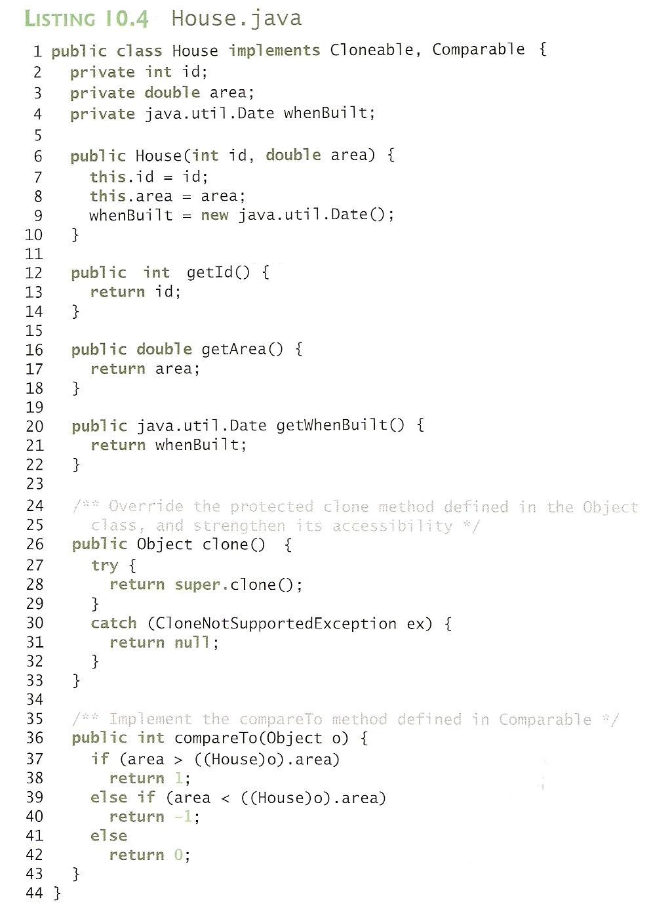
House
Notes:
The House class overrides the clone method (line 26-33) defined in the Object class.
The clone method in the Object class is defined as follows:
Protected native Object clone() throws CloneNotSupportedExeption;
The keyword native indicates that this method is not written in Java, but is implemented in the JVM for the native platform.
The keyword protected restricts the method to be accessed in the same package or in a subclass.
→Cloneable class must override the method and change the visibility modifier to public so that the method can be used in any package.
The House class overrides the compareTo method (line 36-43) defined in the Comparable interface.
The method compares the areas of two houses.
House house1 = new House (1, 1750.50);
House house2 = (House) house1.clone();

Slide 12
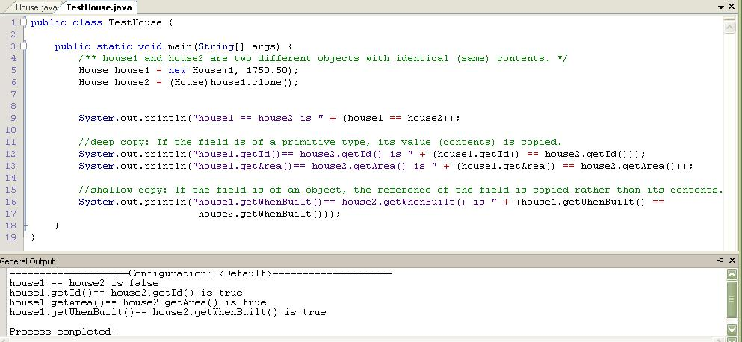
Cloneable Interface Example (3/3)

Slide 13
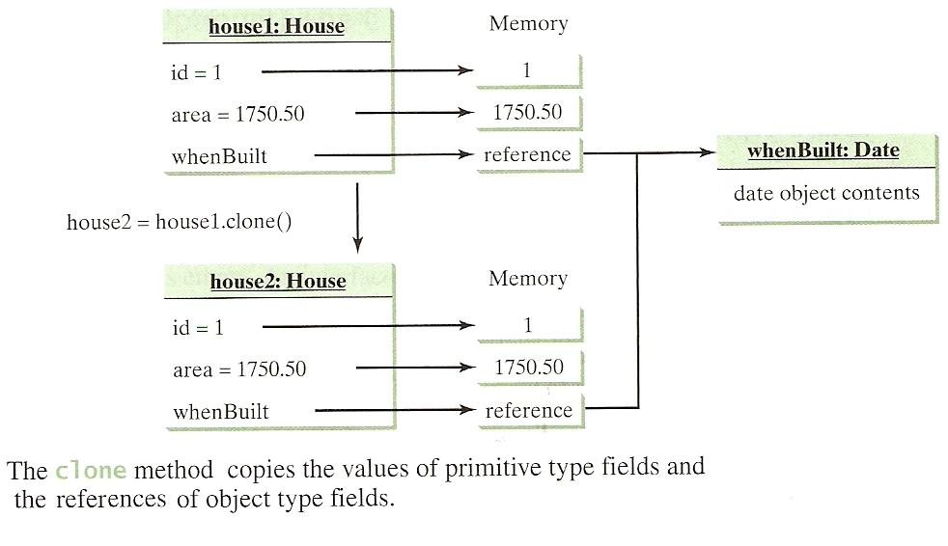
Cloneable Interface Example (1/3)

Slide 14
Shallow vs. Deep Copy
Shallow copy- The reference of the field is copied rather than its contents, e.g.
House house1 = new House(1, 1750.50);
    House house2 = house1;
Deep copy - The contents of all the data fields are copied, e.g.
House house1 = new House(1, 1750.50);
    House house2 = (House)house1.clone();

Slide 15
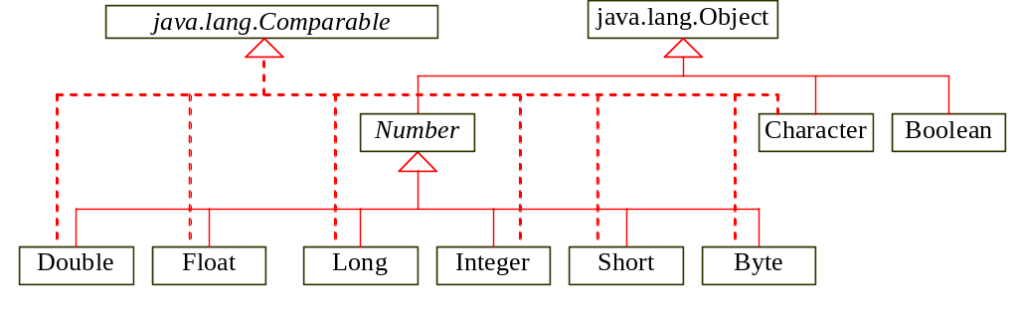
3. Wrapper Classes (1)
Java provides wrapper classes for all primitive types: Boolean, Character, Double, Float, Byte, Short, Integer, and Long.

Slide 16
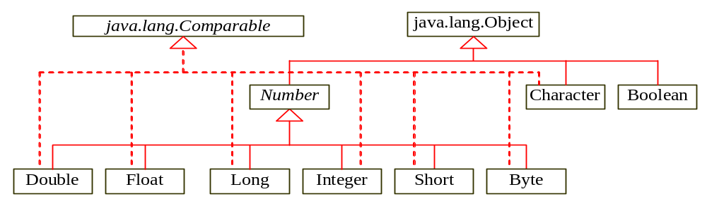
Wrapper Classes (2)
The instances of all wrapper classes are immutable, i.e., their internal values cannot be changed once the objects are created.
Each wrapper class overrides the toString, and equals methods defined in the Object class.
Since all the numeric wrapper classes and the Character class implement the Comparable interface, the compareTo method is implemented in these classes.

Slide 17
Wrapper Classes (3)
Wrapper classes enables your program to process primitive values as objects.
Eg : double x = 5.8; // primitive type
Double doubleObject = new Double(5.8);
By using a wrapper object instead of a primitive data type variable, you can take advantage of generic programming.
Many Java methods require the use of objects as arguments.
  Eg java.util.Arrays.sort (Object [] a)

Slide 18
Example : Sorting an Array of Objects(1)
Objective: The example presents a generic method for sorting an array of objects. The objects are instances of the Comparable interface and they are compared using the compareTo method.
GenericSort

Slide 19
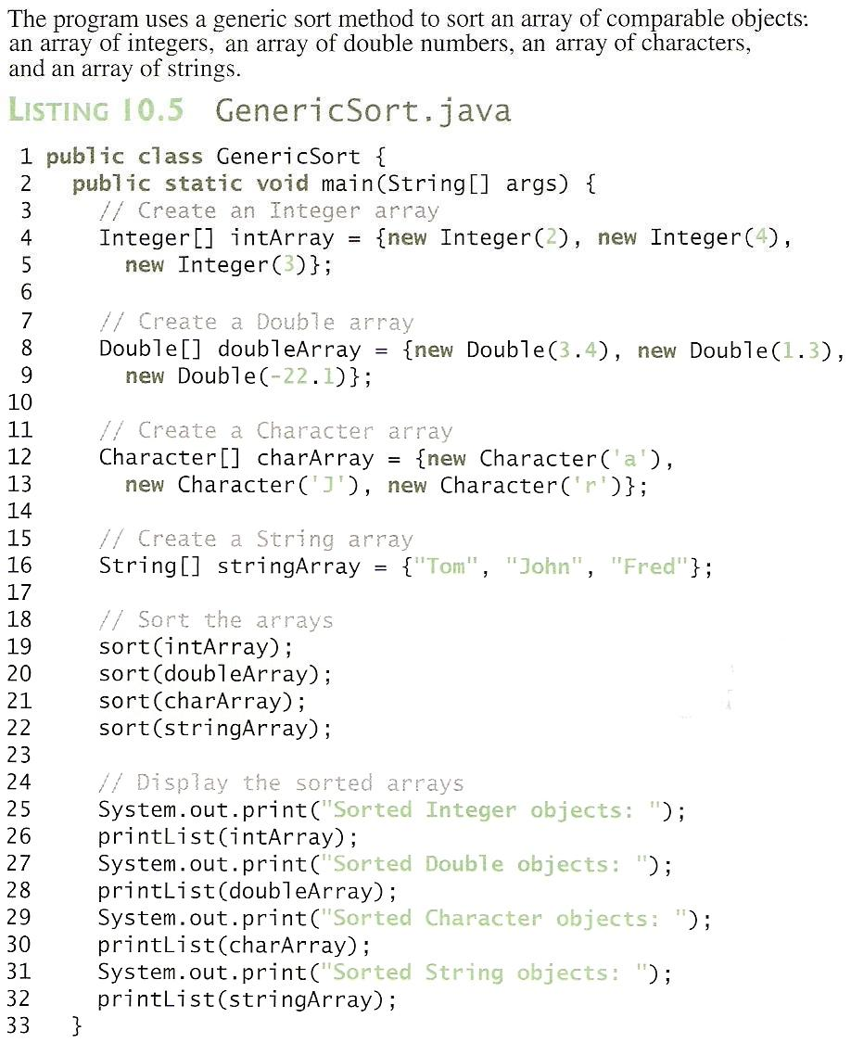
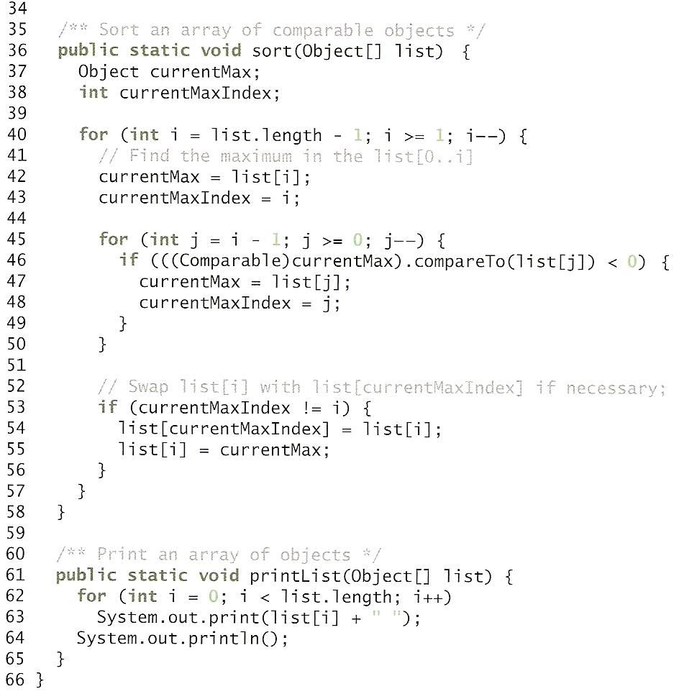
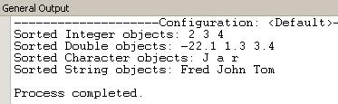
Example : Sorting an Array of Objects (2)

Slide 20
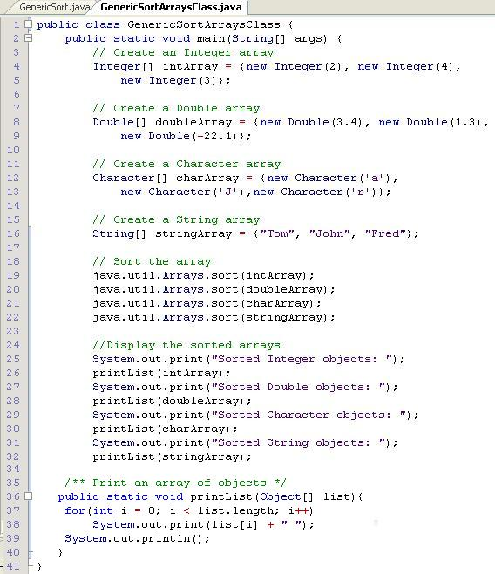
Example : Sorting an Array of Objects (3)

Slide 21
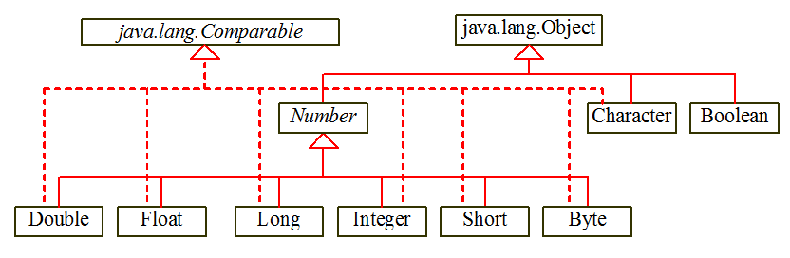
4. The Number Class
Each numeric wrapper class extends the abstract Number class.

Slide 22
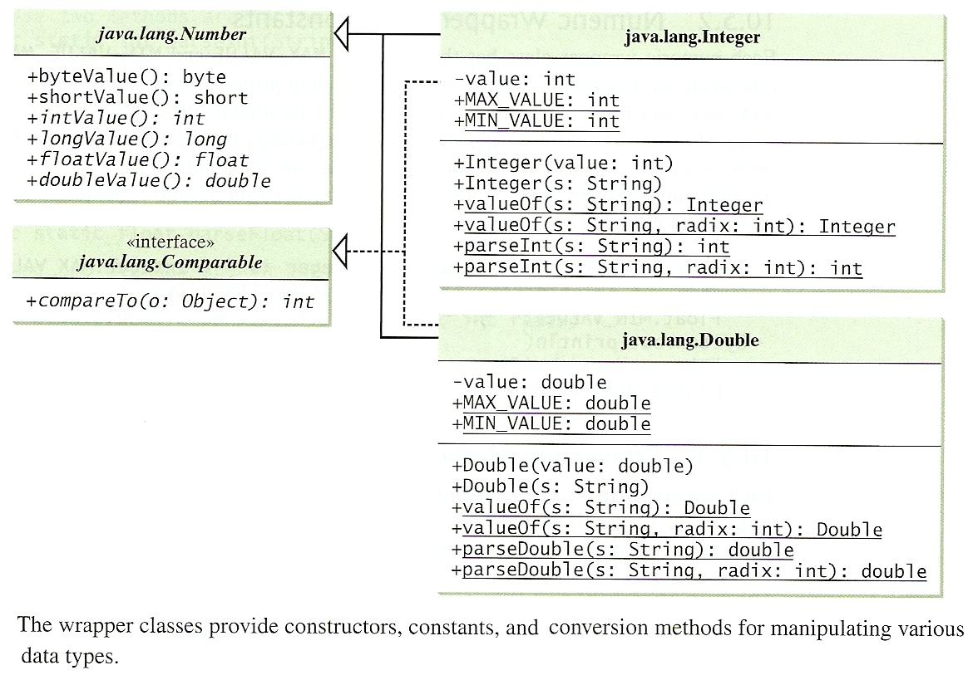
The Number Class
Contains methods doubleValue, floatValue, intValue, longValue, shortValue, and byteValue.
These methods “convert” objects into primitive type values respectively.

Slide 23
The Integer and Double Classes

Slide 24
Numeric Wrapper Class Constructor
You can construct a wrapper object either from a primitive data type value or from a string representing the numeric value.
  Examples:
  Double a = new Double(5.0);
  Double b = new Double(“5.0”);
  Integer c = new Integer(5);
  Integer d = new Integer(“5”);
Note
  The wrapper classes do not have no-arg constructors.
  The instances of all wrapper classes are immutable.
Notes:
No-arg constructor: public Interger() and public Double().
Immutable: means that their internal values cannot be changed once the objects are created.

Slide 25
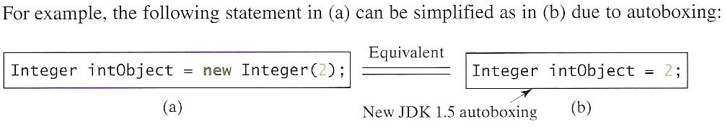
Automatic Conversion Between Primitive Types and Wrapper Class Type (1)
JDK 1.5 allows primitive types and wrapper classes to be converted automatically.

Slide 26
Automatic Conversion Between Primitive Types and Wrapper Class Type (2)
Converting a primitive value to a wrapper object is called boxing. The reverse conversion is called unboxing.
The JDK 1.5 compiler will automatically box a primitive value that appears in a context requiring an object, and will unbox an object that appears in a context requiring a primitive value, e.g.
/* Primitive values 1, 2 and 3 are automatically boxed into objects new Integer(1), new Integer(2), and new Integer(3). */
Integer[] intArray = {1, 2, 3}
/* Objects intArray[0], intArray[1] and intArray[2] are automatically converted into int values that are added together. */
System.out.println(intArray[0] + intArray[1] +
intArray[2]);

Slide 27
Conversion Methods
Each numeric wrapper class implements the abstract methods doubleValue, floatValue, intValue, longValue, and shortValue, which are defined in the Number class.
These methods “convert” objects into primitive type values, e.g.
  (a) To convert doubleObject’s value to a long variable:
  Double a = new Double(5.0);
  long l = a.longValue();
  (b) Assign the int value of integerObject to i:
int i = c.intValue();
(c) To convert double d to a string s:
double d = 5.9;
Double x = new Double(d);
String s = x.toString();

Slide 28
The Static valueOf Methods
The numeric wrapper classes have a useful class method, valueOf(String s).
This method creates a new object initialized to the value represented by the specified string.
E.g.: Double m = Double.valueOf("12.4");
  Integer n = Integer.valueOf("12");

Slide 29
Methods for Parsing
String into Numbers (1)
The parseInt method in the Integer class parses a numeric string into an int value.
The parseDouble method in the Double class parses a numeric string into an double value.
Each numeric wrapper class has two overloaded parsing methods to parse a numeric string into appropriate numeric value based on 10 (decimal) or any specified radix (e.g., 2 for binary, 8 for octal, and 16 for hexadecimal).

Slide 30
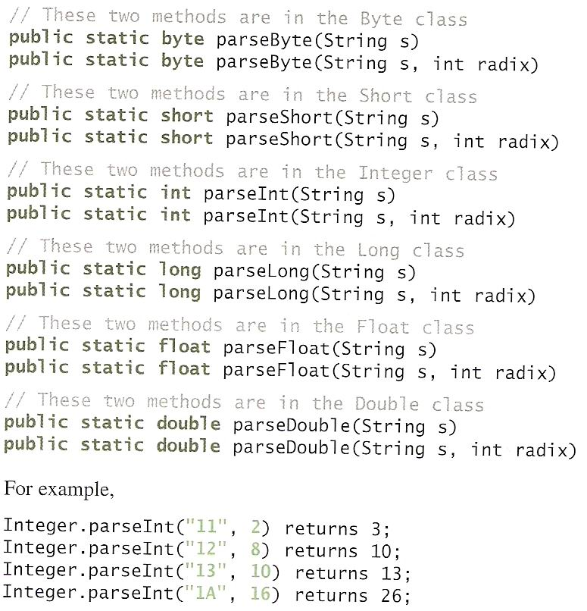
The Methods for Parsing
String into Number (2)
Demo 7.8
Notes:
Integer.parseInt(“12”, 2) would raise a runtime exception because 12 is not a binary number.

Slide 31
To Do
Review the slides and source code for this chapter.
Read up the relevant portions of the recommended text.
Do the tutorial and complete the remaining practical questions for this chapter.
  We shall selectively discuss them during class.

